Slide 1
AstroVitals AI
BY: Ethan Phan
Intelligent Monitoring for Astronaut Health in Space
Company name

Slide 2
Introduction
This presentation explores AstroVitals AI, a groundbreaking system for monitoring astronaut health in space. It addresses the medical risks faced by astronauts and the limitations of existing monitoring systems, while highlighting the potential of AI to enable proactive health interventions.

Slide 3
01
Challenges

Slide 4
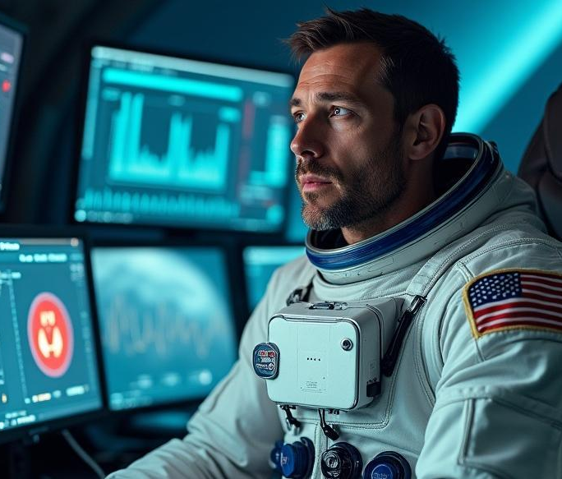
Medical risks for astronauts
Astronauts are exposed to numerous medical risks during space missions, including increased radiation exposure, cardiovascular stress, and mental health challenges. These conditions can lead to serious health issues that may compromise mission success and the safety of crew members.

Slide 5
Limitations of current monitoring
Current monitoring systems for astronauts tend to be passive and delayed, failing to provide real-time insights into health conditions. This lack of timely data can hinder the ability to detect and respond to health risks, making it essential to develop more effective monitoring solutions.

Slide 6
Operational challenges for AI implementation
Implementing AI systems in space presents various operational challenges. Limited onboard computing power may restrict the complexity of algorithms that can be utilized. Additionally, ensuring that AI systems are reliable and resilient in the harsh environment of space is crucial. The need for robust training datasets is also a significant challenge, as health data collected during space missions is sparse and contextually different from Earth-based data.

Slide 7
02
AI Implementation

Slide 8
Real-time data processing
The AI system will enable real-time processing of health data collected from biosensors. By analyzing metrics such as heart rate, oxygen levels, and stress indicators on-site, the system can provide immediate feedback and alerts, helping to ensure timely interventions for astronaut health.

Slide 9

AI model capabilities
AI models, including machine learning techniques like LSTM for time-series analysis, will detect patterns and anomalies in the health data. This capability includes identifying potential health risks and predicting events such as arrhythmias, enhancing proactive care for astronauts.

Slide 10
Ethical considerations and mission value
Implementing AI in astronaut health monitoring raises ethical considerations, particularly regarding data privacy and consent. There is a need to balance the benefits of advanced monitoring with the implications of having personal health data processed by AI systems. Additionally, the integration of AI enhances mission value, reducing reliance on Earth-based medical support and improving autonomous decision-making in space.

Slide 11
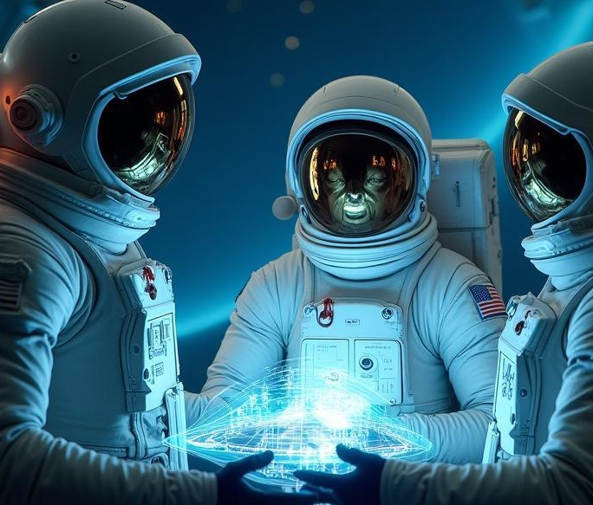
Conclusions
AstroVitals AI represents a significant advancement in astronaut health monitoring, addressing critical challenges and operational needs. By leveraging real-time data processing and sophisticated AI capabilities, it aims to enhance astronaut safety, support mission success, and pave the way for future deep space explorations.

